Slide 1
Challenge 2 V2
DFI Challenge 2
Made By: Mohamed Ahmed

Slide 2
Index
Videos labeling images and feature extraction
Labeling The Images
Use Regional Convolutional Neural Network
Plate Classification Model
Brand Classification Model
Optical Character Recognition for Plate
Yolo Truck Detection
Detect and Recognize Truck Brand
Detection
Classification
Detect Plate and Recognize Characters and Digits
Detection
Segmentation
Classification
Proplems

Slide 3
Labeling Images
First We need to run some videos to extract some truck
3 videos till now
56 Truck
9 brand
Second from cropped truck images we will use makesense a free service the help me for manually
Detect and labeling the brand the 9 brand
Detect the plate

Slide 4
Use Regional Convolutional Neural Network
RCNN
Goal of R-CNN was to take an input image and produce a set of bounding boxes as output, where the each bounding box contains an object and also the category (e.g. car or pedestrian) of the object. More recently, R-CNN has been extended to perform other computer vision tasks.
For bounding box using opencv (createSelectiveSearchSegmentation)
Selective Search works by over-segmenting an image by combining regions based on five key components: Color similarity. Texture similarity. Size similarity. Shape similarity. And a final similarity measure, which is a linear combination of the above four similarity measures.

Slide 5
Use Regional Convolutional Neural Network
Using Intersection over Union
Intersection over Union is an evaluation metric used to measure the accuracy of an object detector on a particular dataset. We often see this evaluation metric used in object detection challenges such as the popular PASCAL VOC challenge, for every bounding box we will find the iou with labeled one from our dataset if it bigger that some ratio so it will be saved our next data set for CNN.
Same algorithm used for plate and brand, creating folder for every brand and plate plus useless boxes for binary classification.
Not all images will be saved (too many to save all in one image almost 1000 bounding box for every image) so will save 10 for each class in every single image.

Slide 6
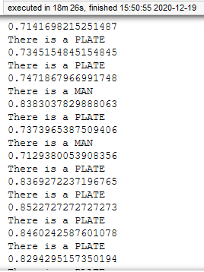
Use Regional Convolutional Neural Network
Algorithm start to detect
Plate with iou ratio
Brand with iou ratio
Every ratio need to exceed 0.7

Slide 7
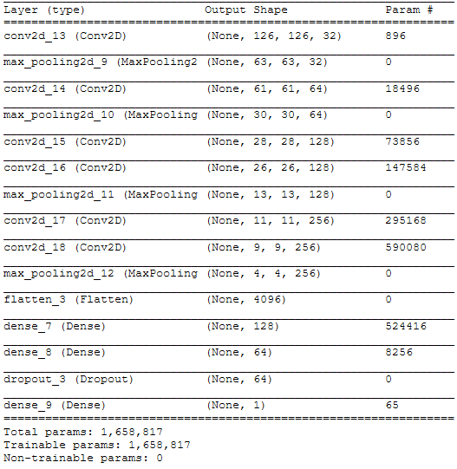
Plate Classification Model
Will train our CNN model on dataset that we saved from previous step.
Using image generator binary category
If last neuro using sigmoid will give probability
0 it is useless a background, truck part.
1 it is plate.
On testing will use a ratio to say it is plate

Slide 8
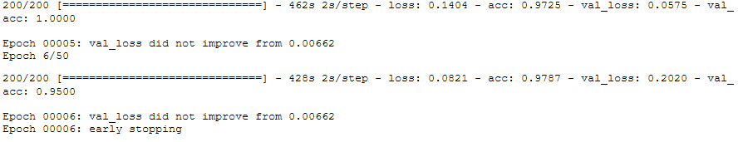

Plate Classification Model
Accuracy reach:
97%
Validation:
95%
With epoch = 50, Batch size 200
Evaluation

Slide 9
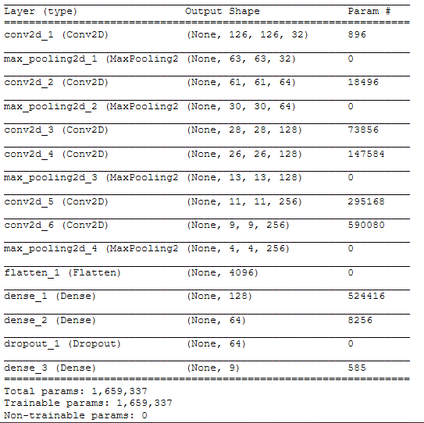
Brand Classification Model
Same as previous model and dataset of brand
Will train our CNN model
Using image generator multi category (9 brand)
using softmax on output that will give probability for every brand.
max probability index will be our brand.

Slide 10
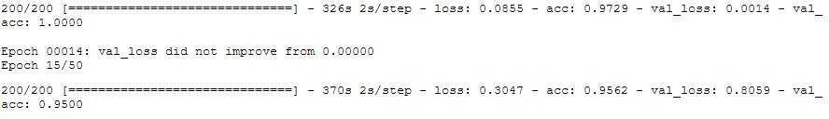

Brand Classification Model
Accuracy reach:
97%
Validation:
100%
With epoch = 50, Batch size 200
Evaluation

Slide 11
Optical Character Recognition for Plate
Here we will use a dataset for character
26 characters.
10 digits.
37660 sample of jpg images (80, 80) pixel.
Will use MobileNetV2:
is a convolutional neural network architecture that seeks to perform well on mobile devices. ... As a whole, the architecture of MobileNetV2 contains the initial fully convolution layer with 32 filters, followed by 19 residual bottleneck layers.

Slide 12
Optical Character Recognition for Plate
8h !!!!!!!!!!!!!.
For just finishing one epoch it will take 8 hour.
From paper I attach it’s seem the best architecture for OCR that why I tried to use it.
So
I return to the old EMNIT Model from v1 and do same (“more faster”)
Not so accurate but if there is GPU it will be good

Slide 13
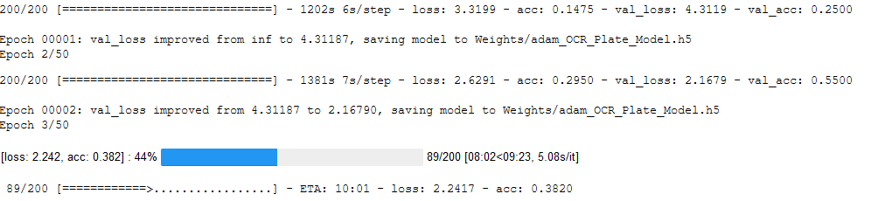
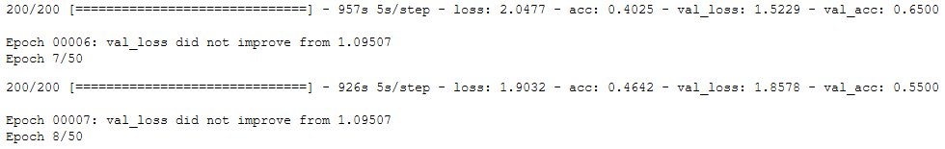
Optical Character Recognition for Plate
still On taring but need more time
But as we can see it’s accuracy and validation is increasing over epoch
After 4 hours only reach 60% as an accuracy.

Slide 14
Yolo Truck Detection
For Truck Detection we used yolo3:
uses a variant of Darknet, which originally has 53 layer network trained on Imagenet. For the task of detection, 53 more layers are stacked onto it, giving us a 106 layer fully convolutional underlying architecture for YOLO v3.
And used this pre-trained network with it’s weight that can detect many clasees like cars, cats and persons.
But question here why we used this ?
We don’t have a data set for trucks and other stuff to train with like data here.
But still can do it with R-CNN (region with convolutional neural network), Fast R-CNN, Mask R-CNN.
Even If We implement Previous Modules, Still where is the data?
We cant depend on the data we cropped from yolo3 not a way to be sure our module work fine.
Modifying the yolo config , classed to detect bus, truck only

Slide 15
Detect and Recognize Truck Brand
From Detection Model We use createSelectiveSearchSegmentation from opencv again to spilt every frame to bounding box.
Feed this boxes to the classification model to decide if it is plate with ratio or useless pic
Using iou to decide the full plate.
0.7 will be our ratio to say it is a part of plate
The overlapping boxes will be our plate image that will be use next

Slide 16
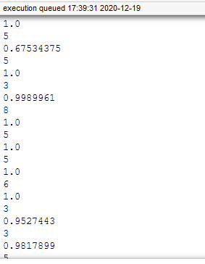
Detect and Recognize Truck Brand
Here the oui of image that match the predicted with
bounding box.
Then will use Non Maximum Suppression
Non Maximum Suppression is a computer vision method that selects a single entity out of many overlapping entities (for example bounding boxes in object detection). The criteria is usually discarding entities that are below a given probability bound. With remaining entities we repeatedly pick the entity with the highest probability, output that as the prediction, and discard any remaining box where a with the box output in the previous step.
We have now a single brand image that can be classified with cnn to get brand

Slide 17
Detect Truck Plate
Same will be here for plate detection
Use createSelectiveSearchSegmentation to create bounding boxes
Iou to decide similarity intersection.
Classify if it is plate or not
Non Maximum Suppression and find the plate image
This time will be 0 for background and 1 for plate

Slide 18
Truck plate segmentation
Noise removal with iterative bilateral filter(removes noise while preserving edges).
Find Edges of the grayscale image.
Find contours based on Edges.
Sort contours based on their area and in some ratio every thing else will be neglected.
loop over our contours to find the best possible approximate contour of number plate.
What are contours?
Contours can be explained simply as a curve joining all the continuous points (along the boundary), having same color or intensity. The contours are a useful tool for shape analysis and object detection and recognition.

Slide 19
Truck plate recognition
For every character and digit from previous segmented image will feed it to OCR model to get classified.
Concat all classified character and this will be our plate

Slide 20
Problems
Image labeling take so much time to detect brand and plate it’s done manually.
Some issues happen with opencv contrib, last version (incompatibility) with the installed opencv package, when installed the opencv wouldn't open any .mp4 videos, that take much time to solve it from reinstall and deleting old version.
The training time for each model take so much time, did it locally, google colab and on server to over come the low training performance.
One frame will be tested on 5 model [brand detection, brand classification, plate detection, plate segmentation, plate character recognition].
Almost 81 original truck image was not enough to get plate detected right.
Every image produce dozen of boxes and all need to get predicted.

Slide 21

Problems
The RCNN Seem Not Working so good
Need to feed it with brand and plate data
Model converge so high only depend on the useless images
The average of segmentation 1 Brand For 10 Background
Same 1 Plate For 10 Background
Memory Keep Increasing and cant restart kernel that make the workspace so slow.
At the end I return to V1 (Simplicity Win this Time)

